Slide 1
The Inbetweeners
In between each round, you will be shown a picture that is in some way linked to someone famous.
Can you guess who?
There will be 8 clues in total (all relating to the same person).
Early clues will (hopefully) be tricky.
Subsequent clues should make it more likely that you can identify the person.
Each clue will appear during the break between rounds and will NOT be shown again.
You may guess after each picture is shown. There will be NO negative marking.
You won’t be told if you are correct or not until all the pictures have been shown.
The sooner that you guess correctly, the more you will score. (ie. correct answer after first picture = 10 points, correct answer only on last picture = 2 points).
GOOD LUCK!!!

Slide 2
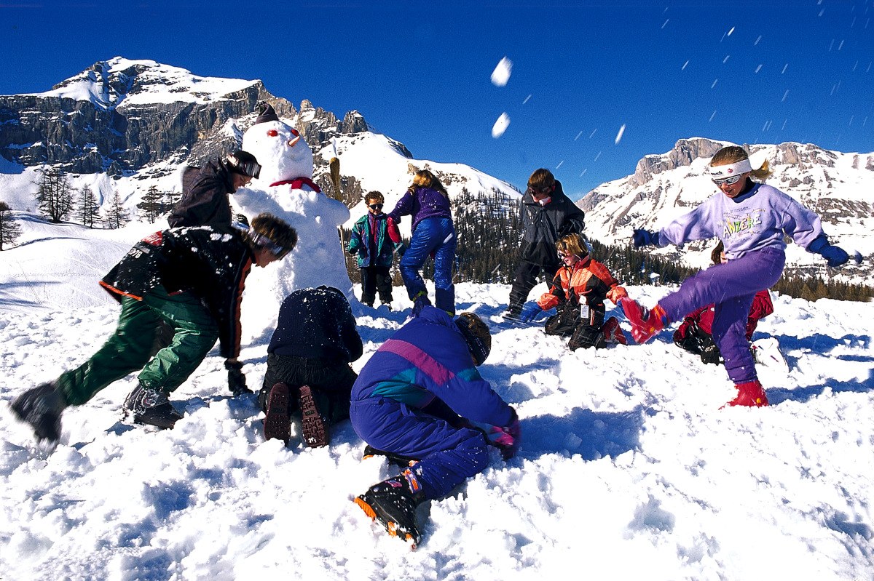
10 points

Slide 3
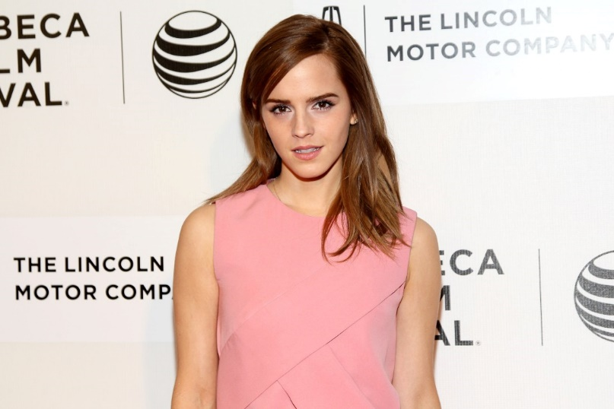
9 points

Slide 4

8 points

Slide 5
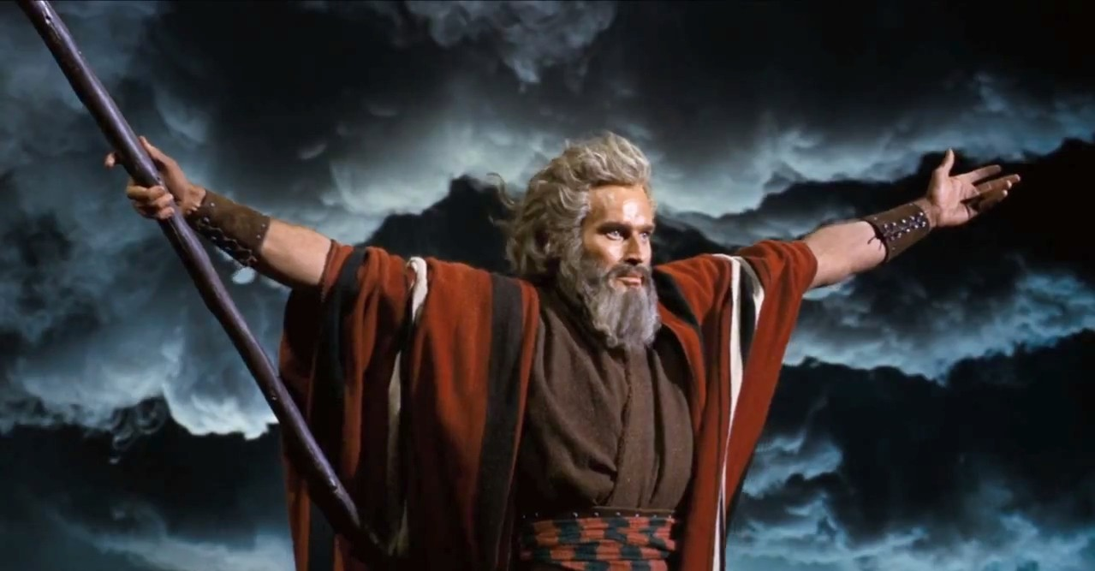
7 points

Slide 6
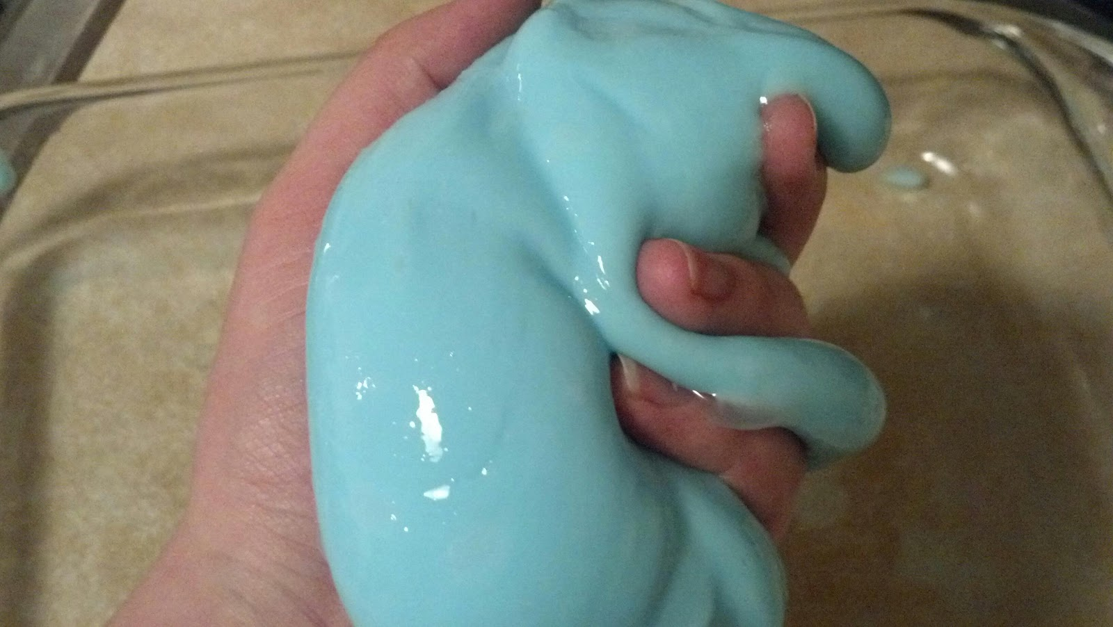
6 points

Slide 7
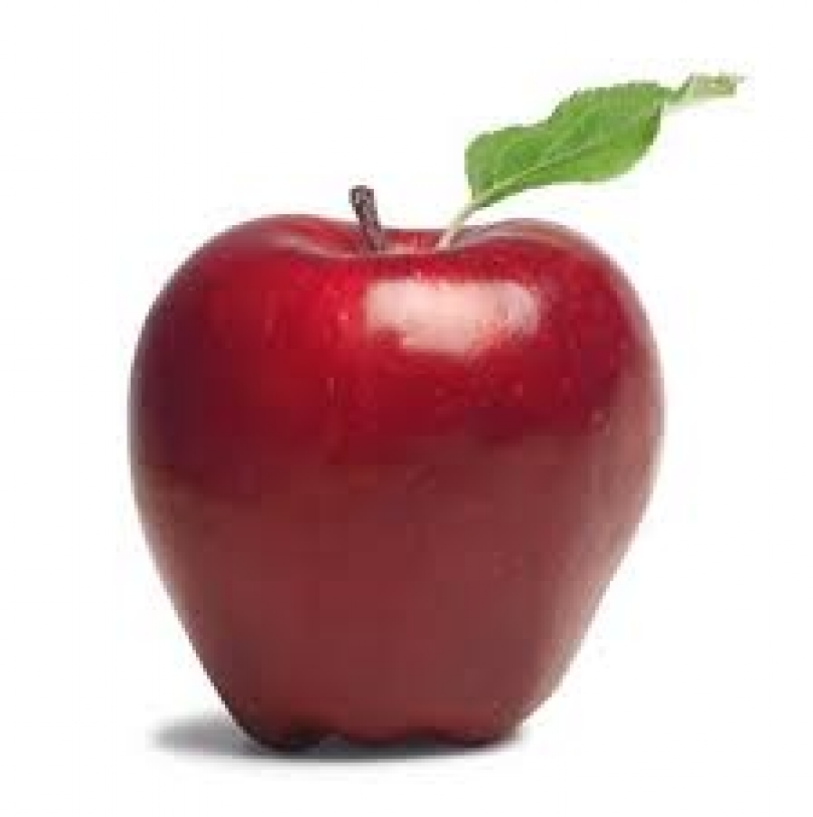
5 points

Slide 8
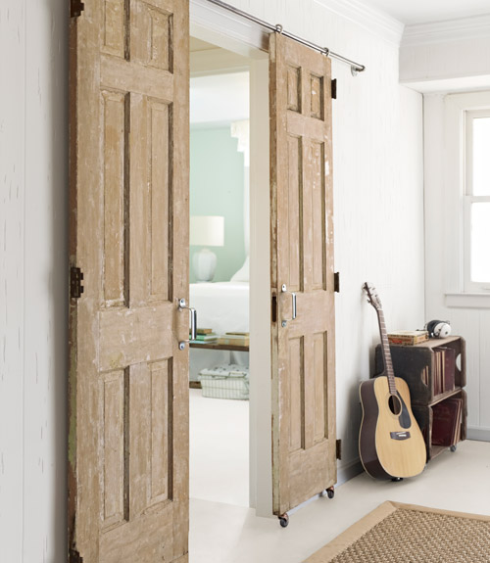
4 points

Slide 9
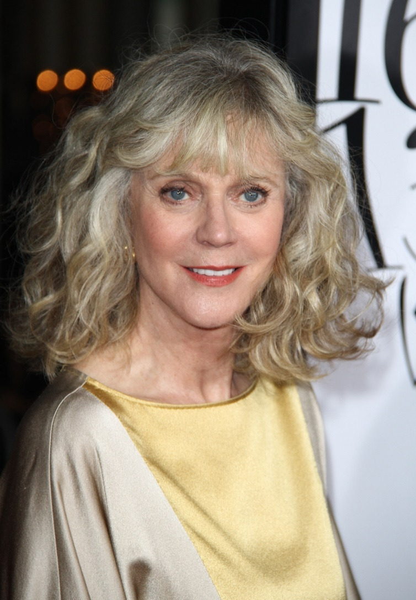
3 points

Slide 10
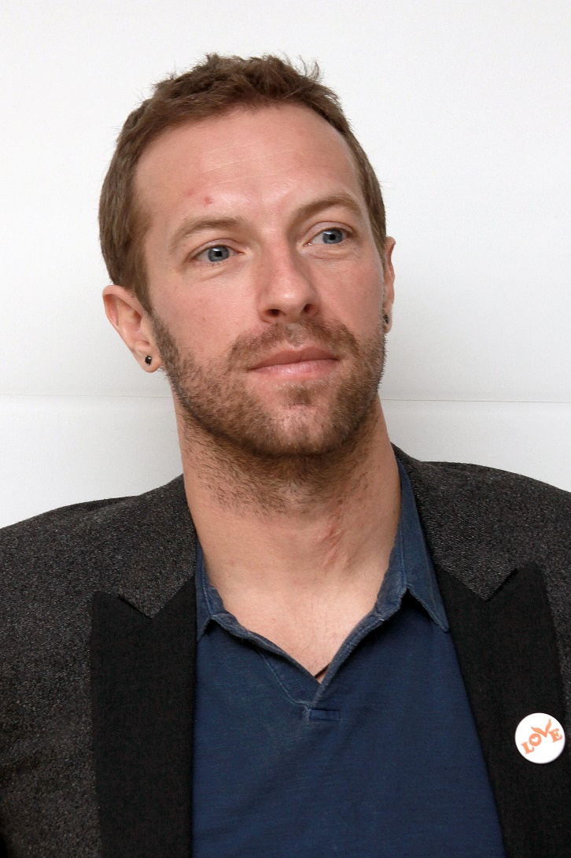
2 points

Slide 11

Who am I?

